Slide 1

Term Project
Topic- Pack-Man
Team Member:
Akshat Ramanathan- 002773371
Janvi Modi- 002702428
Harshit Prajapati- 002762079
Aishwarya Nagaraj- 002700659

Slide 2

Introduction
Pack-Man is a Courier delivery system which has multiple enterprises.
User Roles | Enterprise
Customer | Transport service
Sys Admin | Customer service
Enterprise Admin | Employee Management System
Reginal Manager | Package Management System
Customer Service Associate
.​

Slide 3
User Roles
Customer
The customer can perform the following actions:
Login:
The customer has to login on Pack-man in order to search the nearby Packing services, track shipment if any or post a query.
If the customer is an already existing member, click on the login button and enter the ID.
If the customer is not a member, then he/she has to register in order to access Packman.
2. Search:
The customer can search for any packing services near them by selecting the city name under the dropdown and entering the postal code.
3. Track Shipment:
The customer can track their package
4. Contact us:
Here the customer can contact if needed

Slide 4
User Roles
5. Sys Admin:
Enterprise Admin CRUD
6. Enterprise Admin:
RM CRUD (Employee Management)
Package Status Modification(Transport Service)
Reply to customer(Customer Service)
7. Regional Manager:
CSA CRUD
Franchise CRUD
8. Customer Service Associate:
Package CRUD

Slide 5
Enterprise
Transport service:
Customer Flow:
Enter tracking ID:
Here the customer has to enter their customer tracking id in order to track their package.
Shipment Details(To, From, ShipmentID, Table for Status)
Here the customer can see their shipping details such as name, address, postal code, number, email id of both the customer and the receiver.
Every customer will be given a Shipment ID as well as a table of status will also shown to the customer in order to check the status.
Transport Admin Flow:
Manage Package ( Shipment ) Details to update Status
Can Manage and update the status

Slide 6
Enterprise
Employee Management System:
Manage CSA or Manage Franchise Screen
CSA CRUD
Filter Functionality by Franchise(optional) else display all.
Here the customer can select their preferred Franchise using filter option otherwise it will display all the franchise by default.
System Admin
Enterprise CRUD
Enterprise Admin
RM CRUD (Package Management), Transport Admin CRUD and Customer Representative CRUD
RM Admin
CSA CRUD, Franchise CRUD
Transport Admin
Status update for shipment
Customer Representative
FAQ, update un-answered queries
Franchise CRUD(with table view)
Here the customer can see all the available Franchise options

Slide 7
Enterprise
Package Management System:
Customer Flow:
Search for nearby Franchise
In order to place the package in person, customers can search for a nearby Franchise.
Request for package
Here the customer can request for package
Customer Service Associate Flow:
Shipment & Package CRUD
Here the employee is in the CSA they can edit the FROM data.

Slide 8
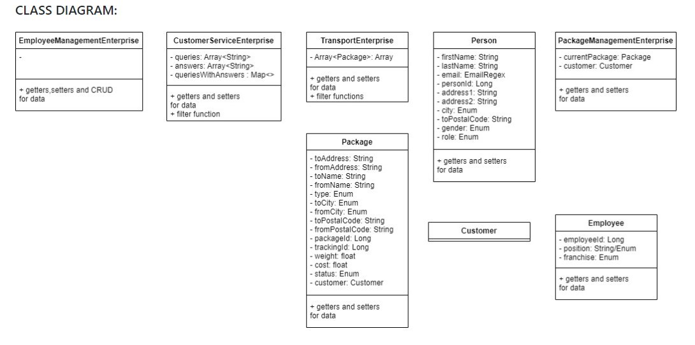
Richard Branson

Slide 9
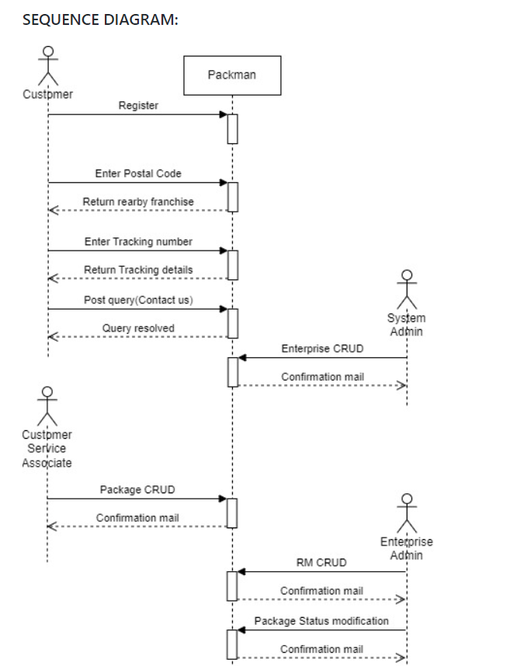
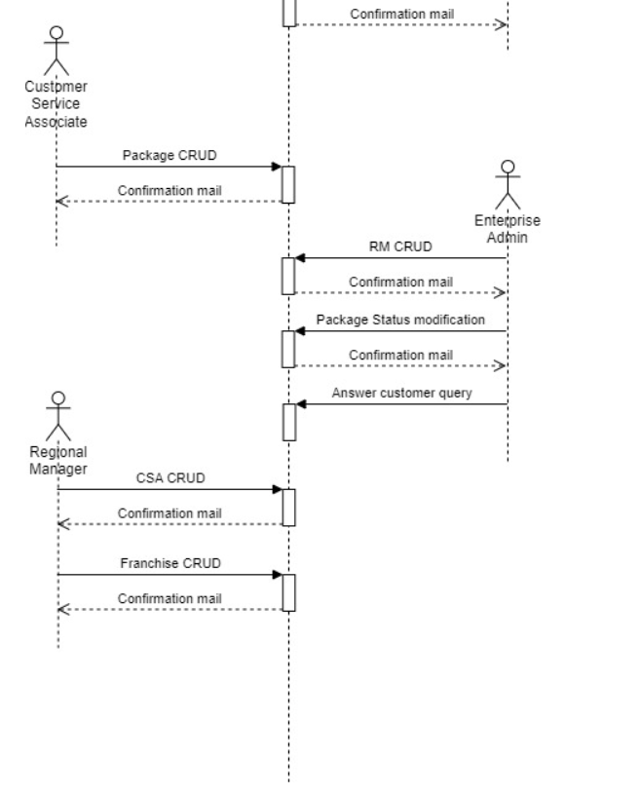
Richard Branson

Slide 10

Thank you

